Slide 1
Looking at Education in Sub Saharan Africa
Ben Merrill

Slide 2
Dataset
The dataset accessed was:
World Development Indicators Dataset

Slide 3
Motivation
Over the course of the last 9 years, nearly one million migrants have illegally crossed the Mediterranean Sea from Libya in hopes to move into Italy and the rest of Europe. It has become one of the largest immigration crises in world history. I work with these refugee populations in Catania, Sicily, a southern Italian island that most migrants land on.
One of the most difficult things that these people face when they arrive in Italy is cultural assimilation. People have diverse backgrounds in education, some finding it easy to learn the Italian language and culture. Unfortunately, there are many people living on the streets, unable to find work and become a part of the Italian society, mostly due to lack of education and corruption (often Mafia-related.)

Slide 4
Research Question
Before writing the research question, here are a few things to note about Catania. The two largest refugee populations come from Nigeria and Senegal, in sub-Saharan Africa. Also, in the last year here, I have only met refugees between the ages of 20 and 40.
Education is one of the largest contributors to people’s inability to assimilate and ending up living on the streets. I believe that the question of education is far too large to tackle here. Here is my question based on the data set and current situation in Catania:
“Are refugees from Senegal or Nigeria more likely to have a strong educational background based on secondary education completion?”

Slide 5
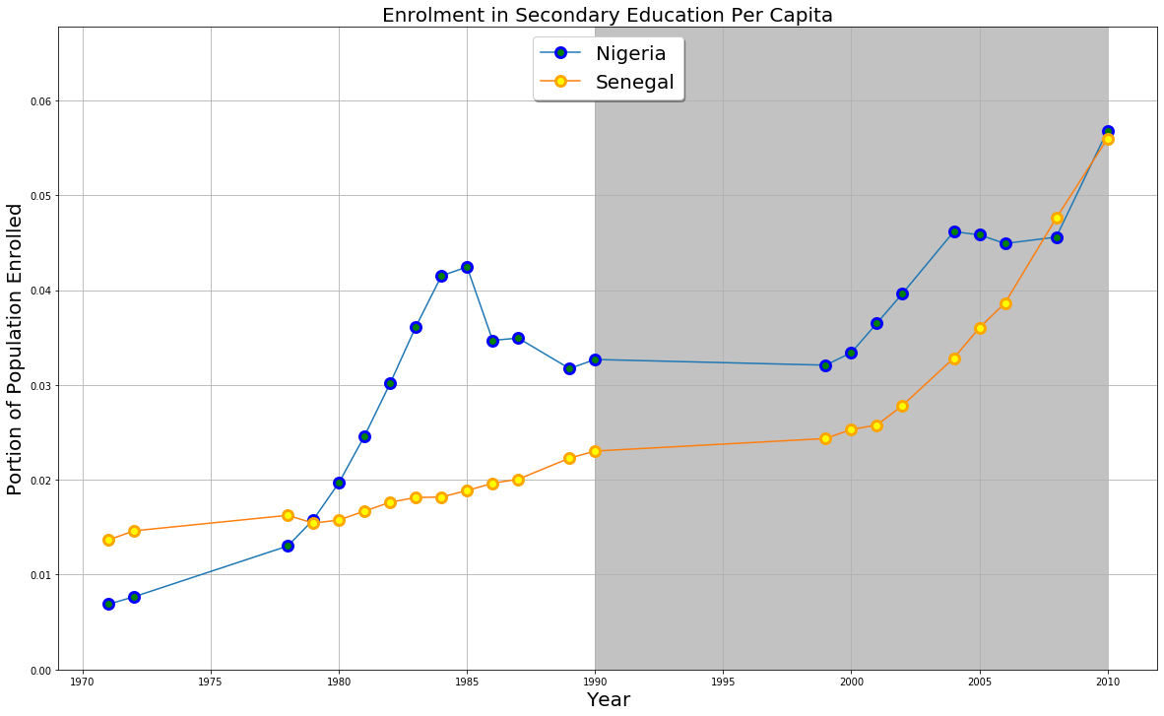
Findings

Slide 6
Findings
Notes on the graph:
The grey area highlights when people 20 – 40
would have been in secondary education
The data is not fully complete
The data shows that a larger percentage of
Nigerians were in secondary education during our years of interest
Conclusion:
We cannot say definitively which population is better educated, but we can conclude that refugees from Nigeria are more likely to have completed secondary education.

Slide 7
Acknowledgements
I didn’t have anyone to give me feedback.

Slide 8
References
‘Mediterranean Situation.’ Operation Portal Refugee Situations, UNHCR, 29 October 2019, https://data2.unhcr.org/en/situations/mediterranean/location/5205

